Slide 1
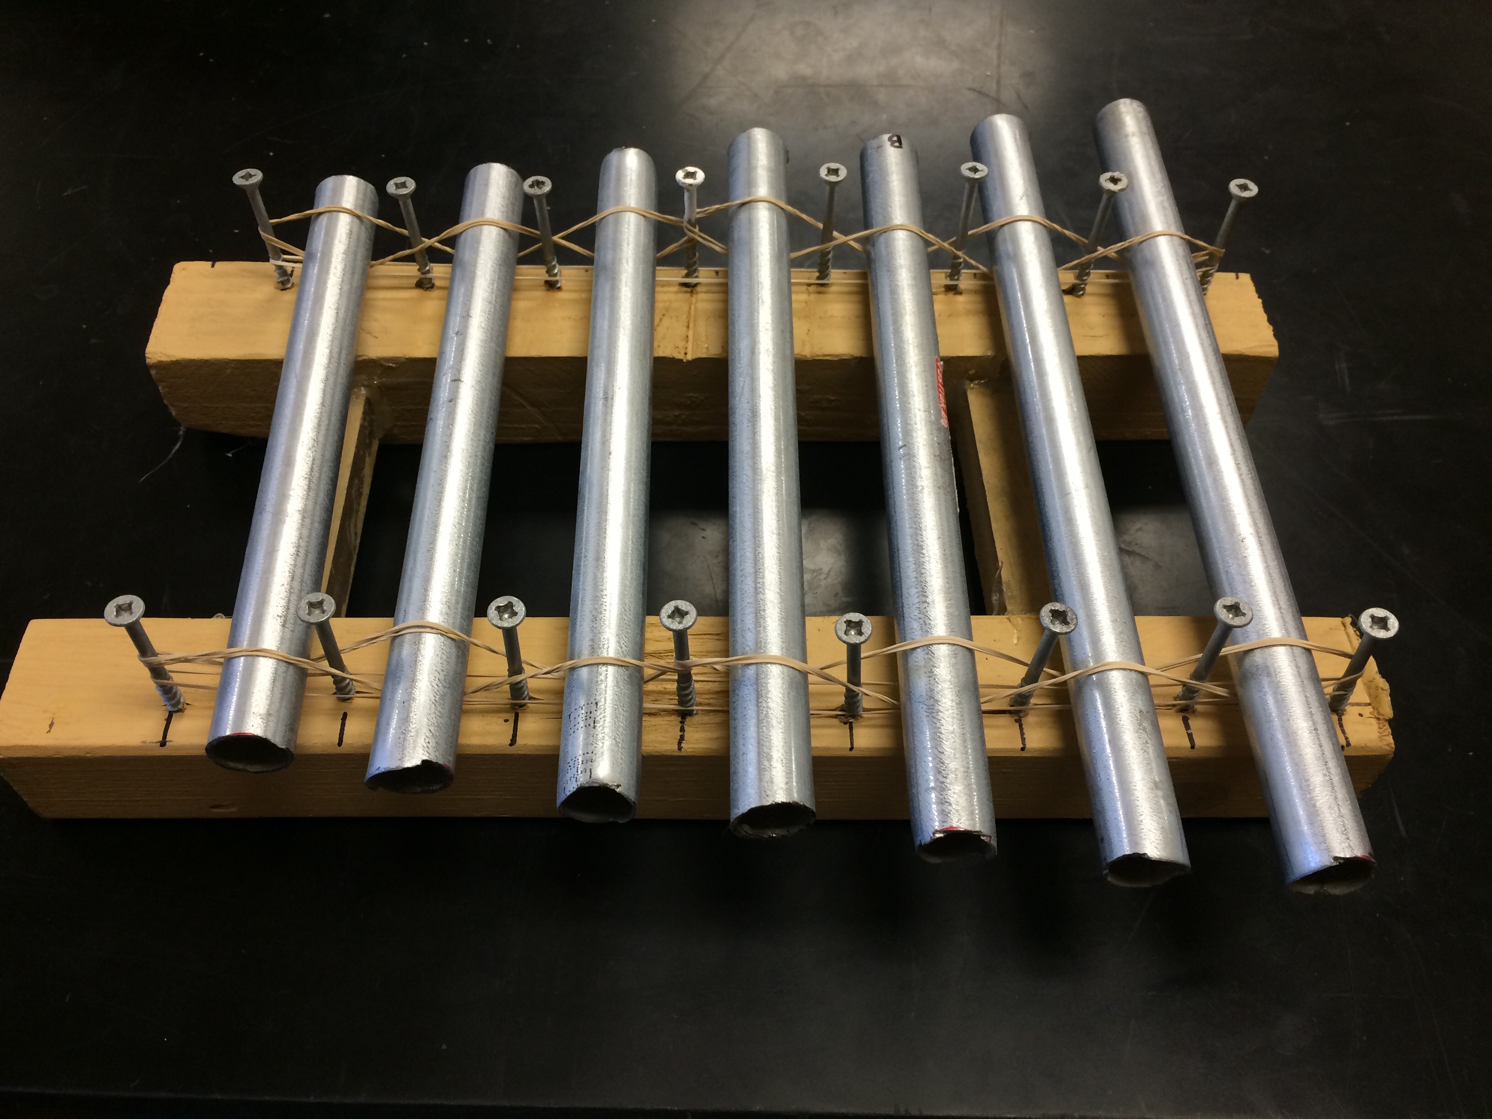
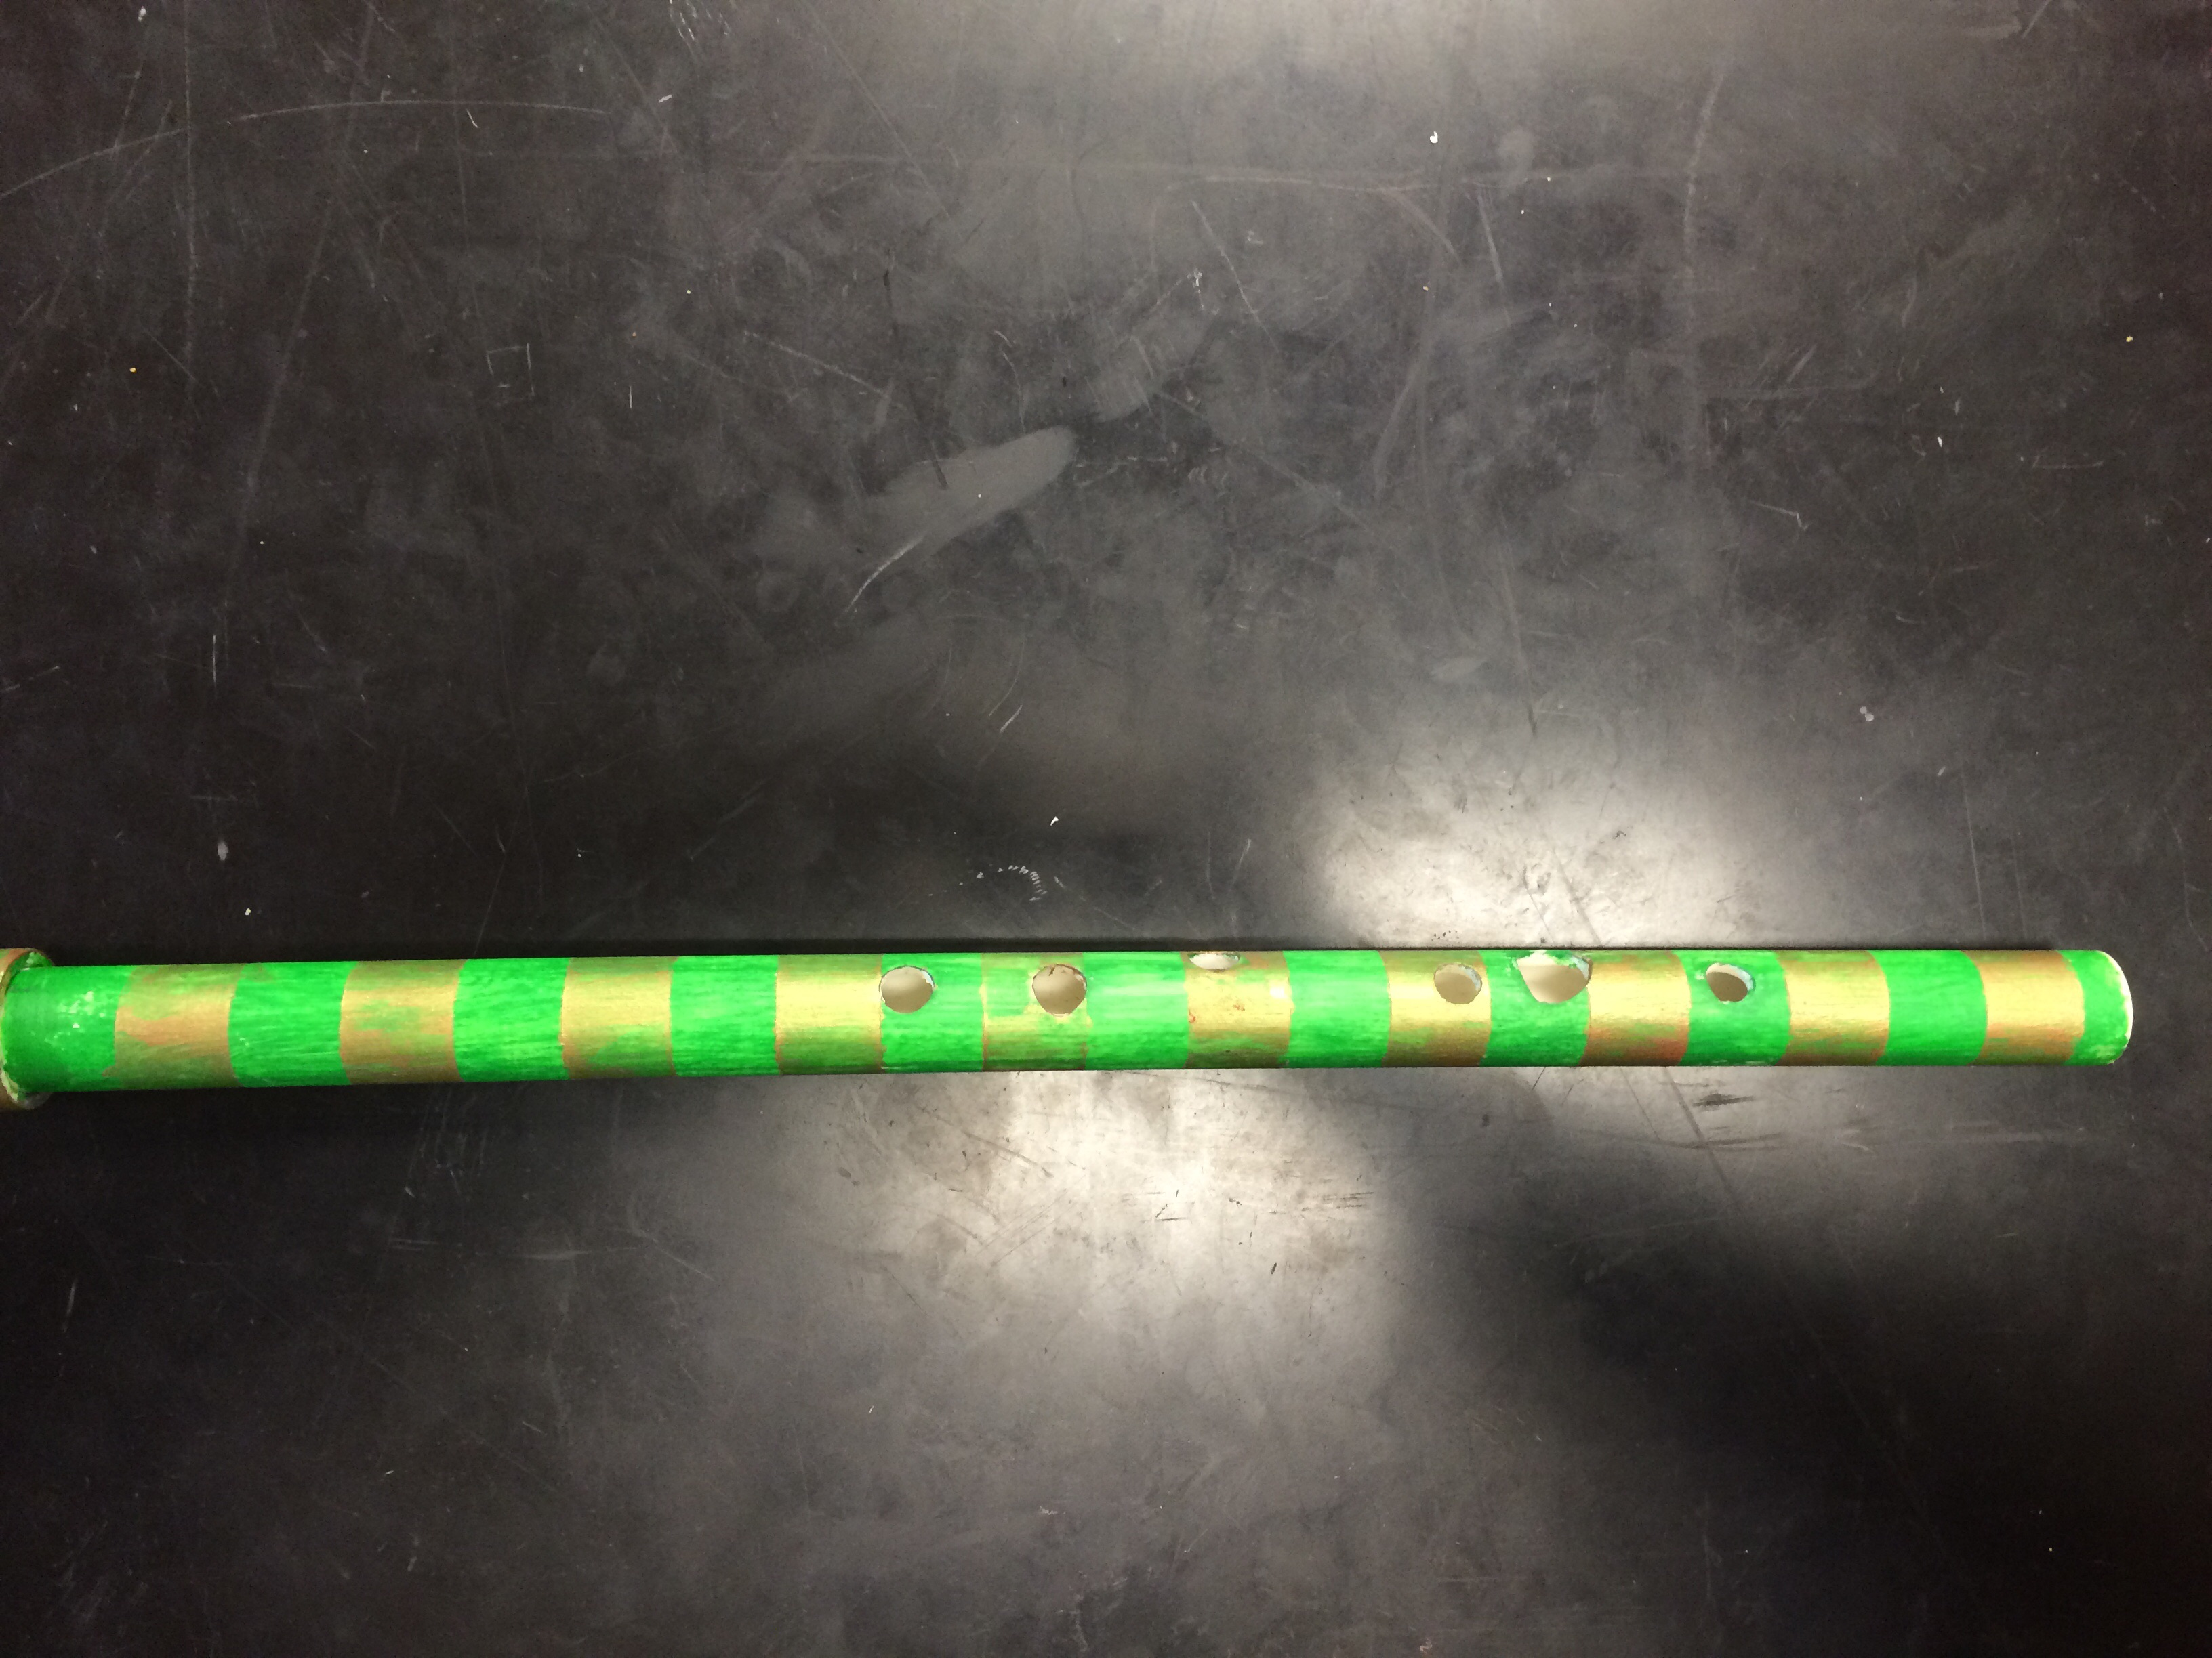
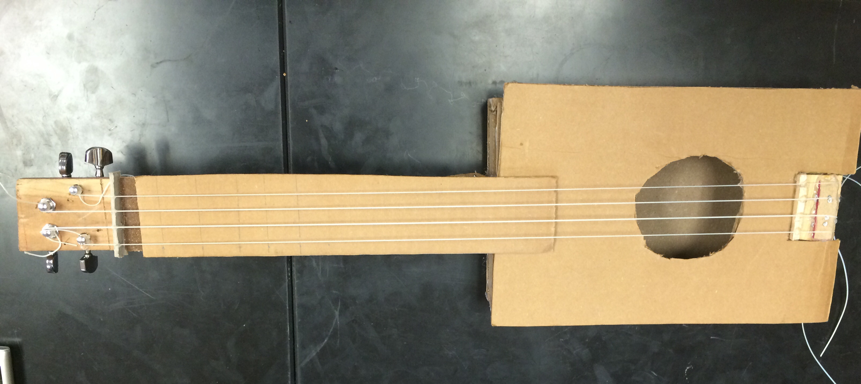
Build a Band
Madi, Parker, Annabel, and Matt

Slide 2
Xylophone
We first made a wooden base. The wooden base consisted of two parallel pieces of wood connected with small wooden blocks. The next thing we did was screwing in the screws halfway into the wooden base. Which created the poles that would hold up the pipes. After screwing we cut metal pipes down to different lines each length makes a different sound. The shorter the metal pipe was the higher pitched the note was. Lastly we fastened the metal pipes to the screws with rubber bands.

Slide 3
Flute
The way sound is produced from a flute is from blowing onto a sharp edge, causing air enclosed in a tube to vibrate. The different notes are created when the vibrating air escapes through an uncovered hole. We figured out the spacing of the holes and the diameter of each hole from a website which showed where and how to place the holes. The size of the holes are significant because the larger the holes the louder the sound because more air escapes. Also the placement of the holes matters because the note will be higher when placed closer to the mouth hole and lower when placed further away and when following that rule you can create the 7 needed notes.

Slide 4
Ukulele
The build a band project required each team to construct a string instrument, air instrument, and precision instrument. Annabelle and I originally took on the task of building a banjo witch transformed into a ukulele. We constructed the ukulele out of wood, screws and hot glue. We then attached the tuners, bridge, and nut to hold the ukulele strings that Annabelle purchased from the music store. Once the strings were tightened and tested we marked out where the frets would need to go. The frets are one of the most important parts of the instrument because it determines the length of the string. This limits the amount of distance the vibrating string can travel which makes the strings produce different notes. For example the strings on the guitar are strung, the vibrations transmit to the saddle. The saddle transmits the vibrations to the sound board. The sound board and the body amplify the sound . Sound then comes out through the sound hole.

